Slide 1

IN432
Advanced Web Programming

Slide 2
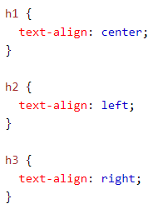

CSS Text
Text Alignment
The text-align property is used to set the horizontal alignment of a text.

Slide 3
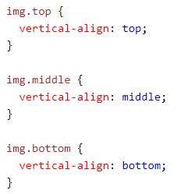
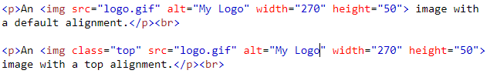
CSS Text
Text Vertical Alignment

Slide 4
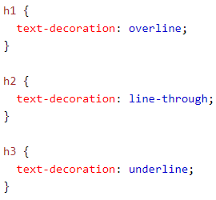
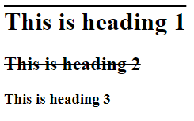
CSS Text
Text Decoration

Slide 5
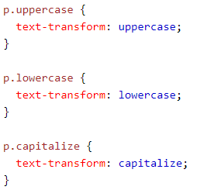
CSS Text
Text Transformation

Slide 6
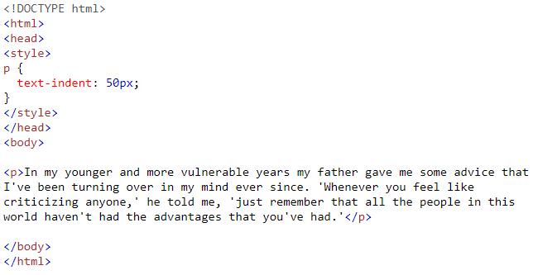
CSS Text
Text Spacing

Slide 7
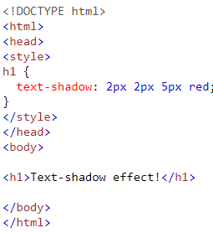

CSS Text
Text Shadow

Slide 8
CSS Text
Text Shadow

Slide 9
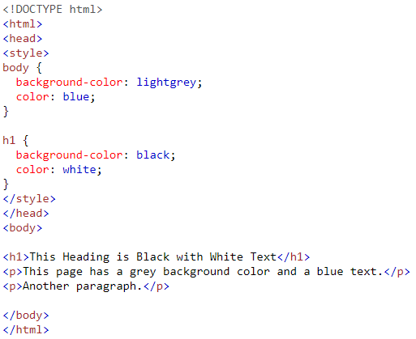
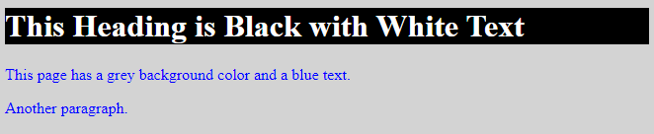
CSS Text
Text Color & Background Color

Slide 10


CSS Backgrounds
CSS background-color
a valid color name - like "red"
a HEX value - like "#ff0000"
an RGB value - like "rgb(255,0,0)"
Opacity / Transparency

Slide 11



CSS Backgrounds
Transparency using RGBA
CSS Background Image

Slide 12


CSS Backgrounds
CSS Background Image

Slide 13
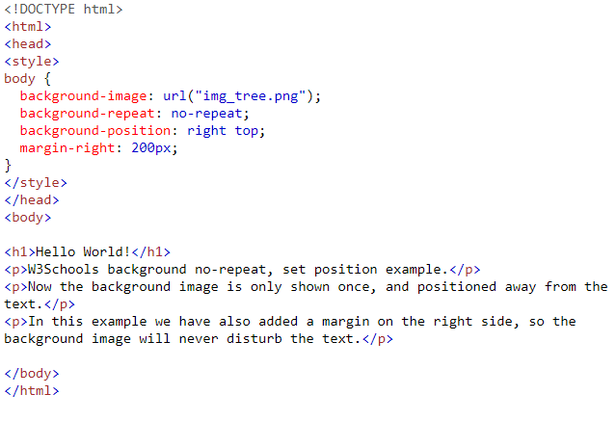
CSS Backgrounds
CSS Background Image

Slide 14
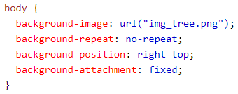
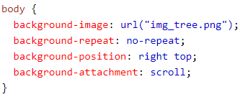
CSS Backgrounds
CSS Background Attachment
The background-attachment property specifies whether the background image should scroll or be fixed (will not scroll with the rest of the page):

Slide 15

CSS Backgrounds
CSS Background ShortHand
Use the shorthand property to set the background properties in one declaration:

Slide 16
CSS Borders
p.dotted {border-style: dotted;}
p.dashed {border-style: dashed;}
p.solid {border-style: solid;}
p.double {border-style: double;}
p.groove {border-style: groove;}
p.ridge {border-style: ridge;}
p.inset {border-style: inset;}
p.outset {border-style: outset;}
p.none {border-style: none;}
p.hidden {border-style: hidden;}
p.mix {border-style: dotted dashed solid double;}

Slide 17
CSS Borders
p {
border: 2px solid red;
border-radius: 5px;
}
The border-radius property is used to add rounded borders to an element
p {
border-left: 6px solid red;
background-color: lightgrey;
}
p {
border-bottom: 6px solid red;
background-color: lightgrey;
}

Slide 18
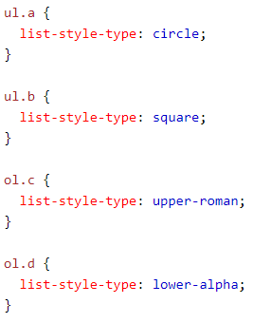
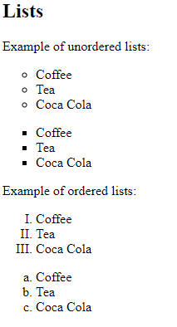
Different List Item Markers

Slide 19
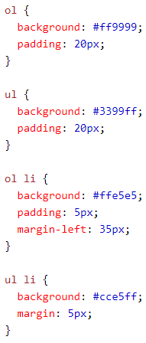
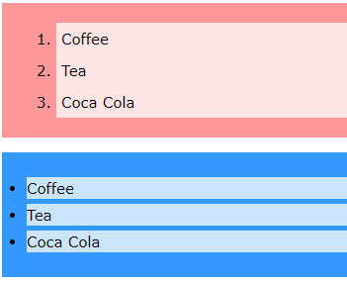
Styling List With Colors
The CSS margin properties are used to create space around elements, outside of any defined borders.
Padding is used to create space around an element's content, inside of any defined borders.

